Slide 1

Confederation

Slide 2
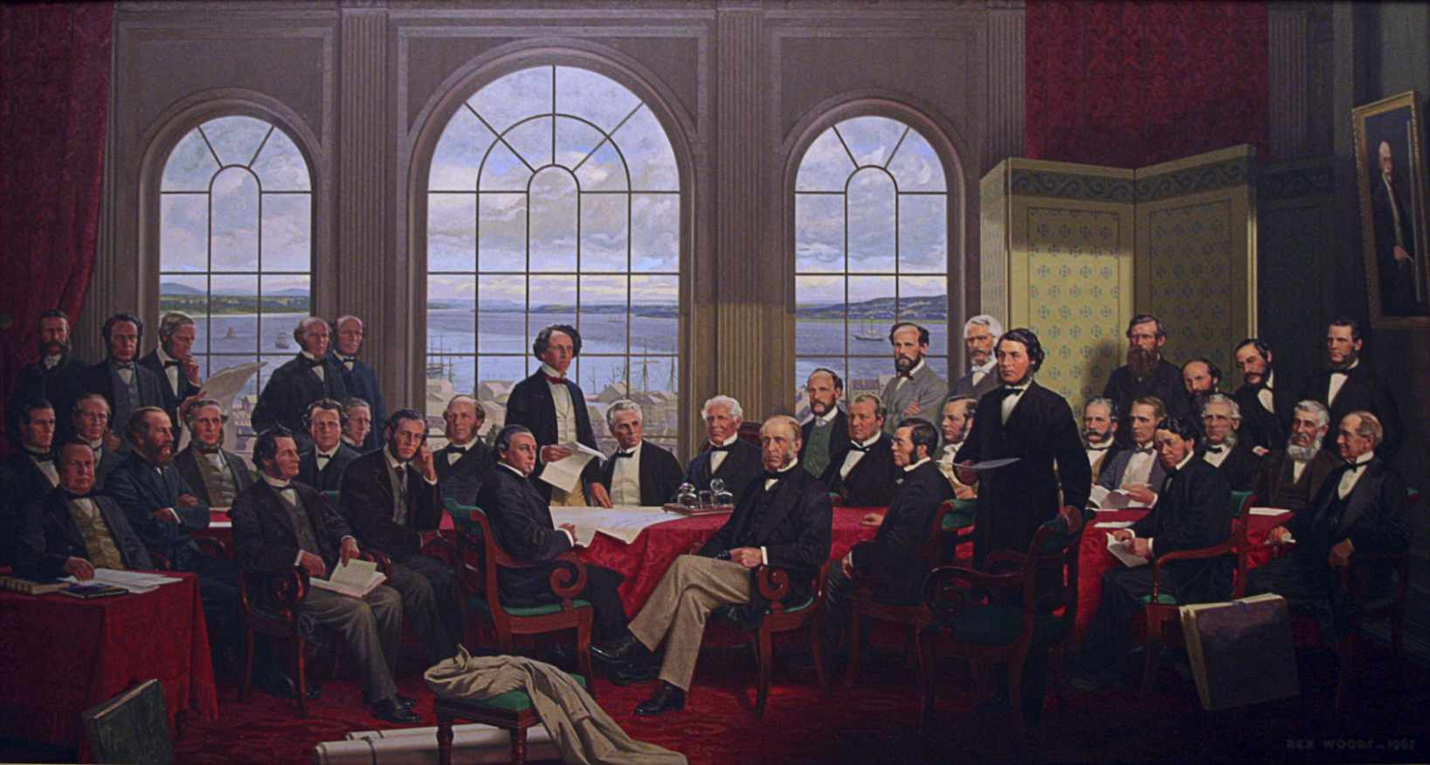
What is Confederation?
The Father’s of Confederation – prominent leaders within the colonies who arranged for the creation of the Dominion of Canada.

Slide 3
Take-away Points
To recognize what Confederation is not:
  Not a moment of popular democracy
  Not a product of mass Canadian nationalism
  To see Confederation as the product of a diverse number of political and economic problems
  To see it as the product of a small group of political and economic elites

Slide 4
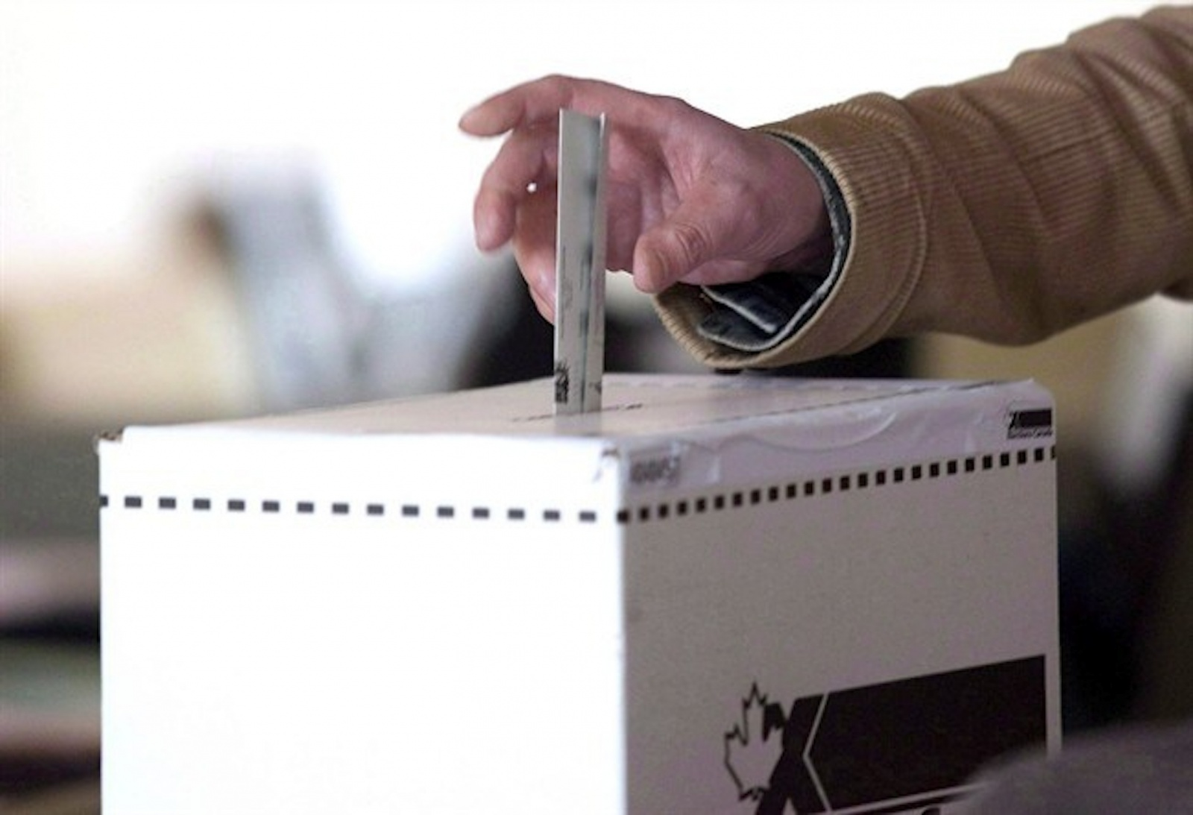
Myth: Confederation was Democratic

Slide 5
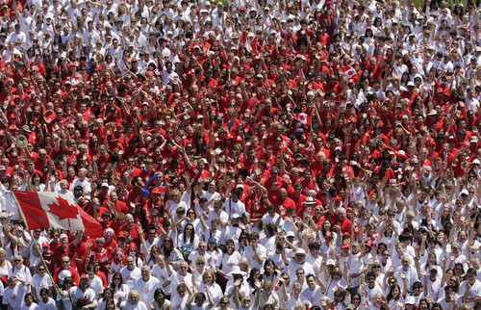
Myth: Confederation as Highly Desired

Slide 6
Political and Economic Factors Influencing Confederation
Military Problems
Political Problems
Economic Problems
  Free Trade
  Industrialization

Slide 7
Charlottetown Conference, 1864
First attempts to negotiate Confederation

Slide 8
Quebec Conference, 1864
Unification
Colony of Canada gets split into Ontario/Quebec
Federalism
House of Commons
Representation by Population
An appointed Senate

Slide 9
Maritimes Respond with 72 Resolutions
Federal/Provincial governments do different things
Feds: defense, transportation, common markets
Provinces: education, religion, social welfare
Feds will pay colony’s debts
Feds will facilitate a inter-colonial railway

Slide 10
Final Negotiations
The Colony of Canada is divided
New Brunswick is divided
Nova Scotia is divided
PEI drops out
Newfoundland not at all into it

Slide 11
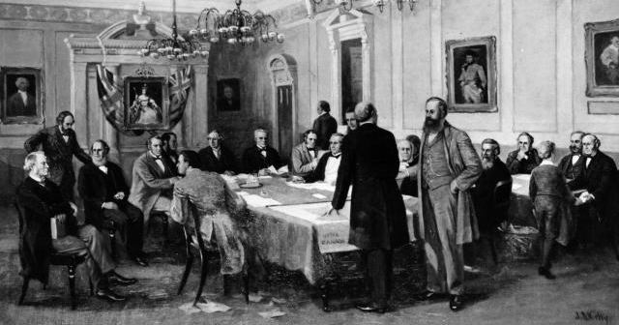
Westminster Conference, 1866
New deals are developed
Britain puts pressure on colonies to sign an agreement

Slide 12
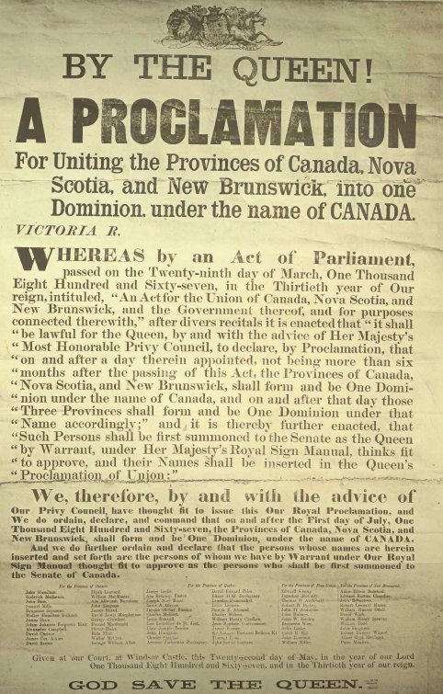
It Works!
July 1, 1867: The British North American Act creates the Dominion of Canada

